Slide 1

PROJECT RESULTS

Slide 2
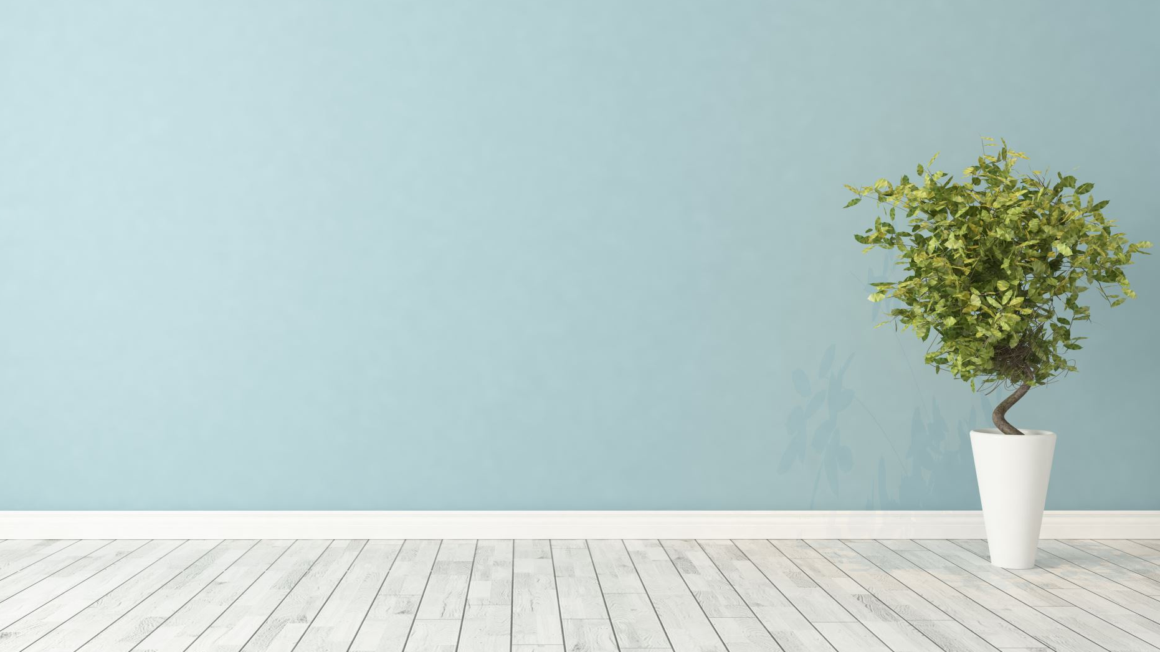
THE GREEN WALL

Slide 3
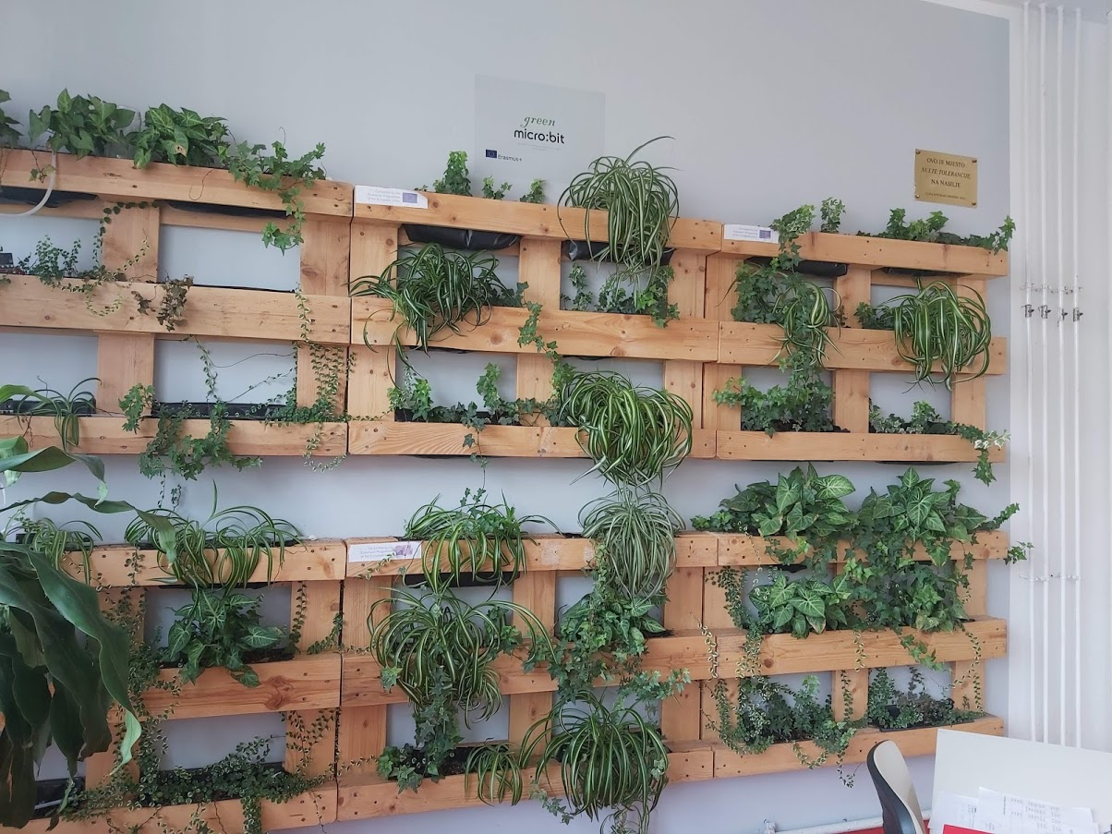
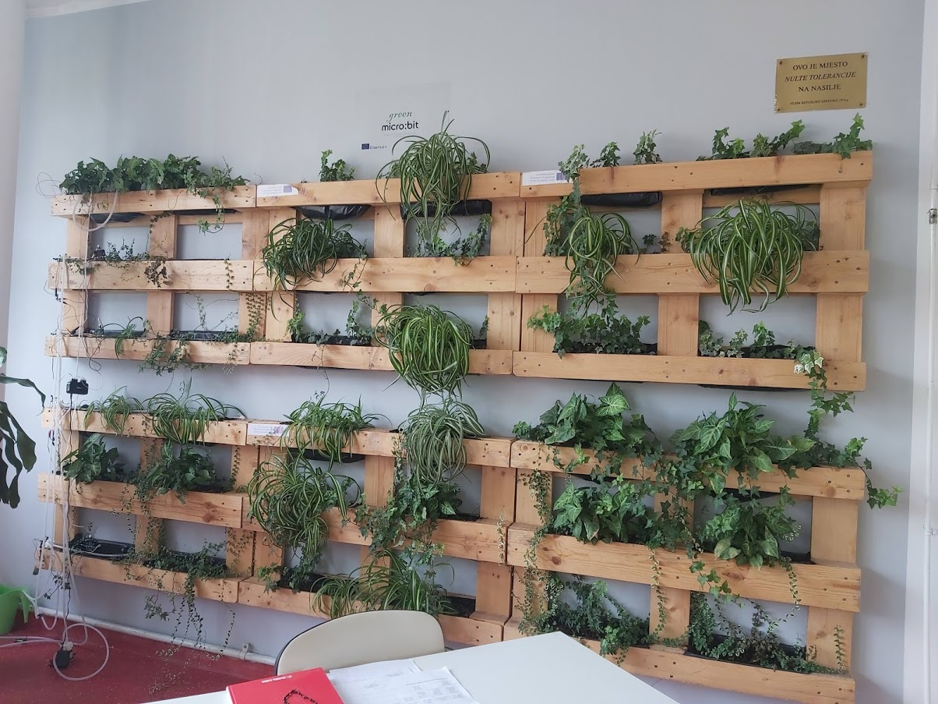
The wall
it’s placed in our entrance hall and it’s very noticeable

Slide 4
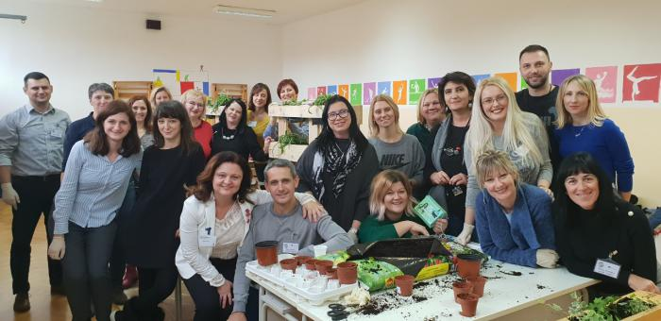
THE CREATING OF THE WALL – teachers’ workshop

Slide 5
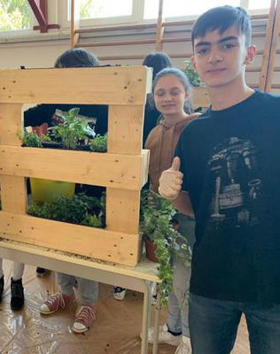
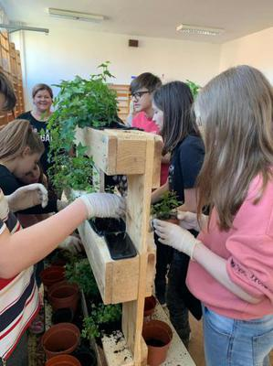
TEAM WORK
- pupils’ workshop

Slide 6
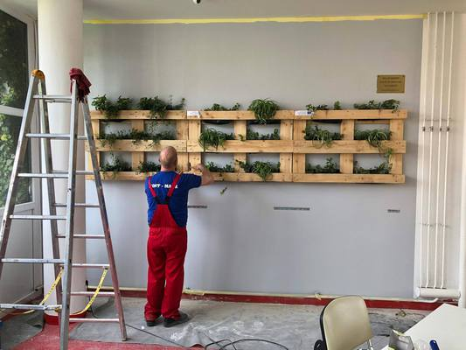
PUTTING UP THE GREEN WALL AND PAINTING THE WALL

Slide 7
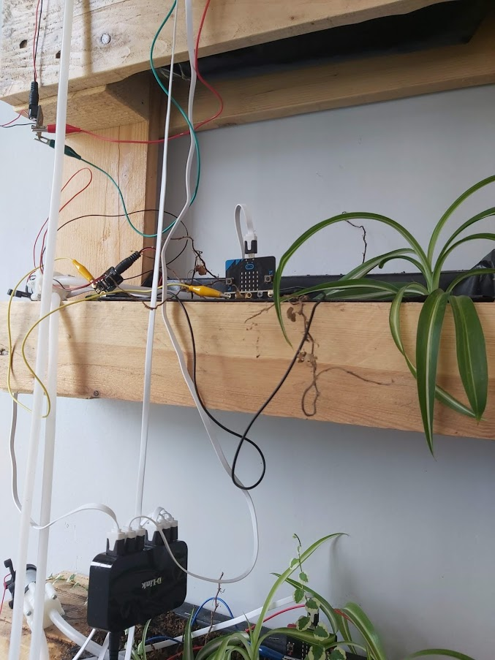
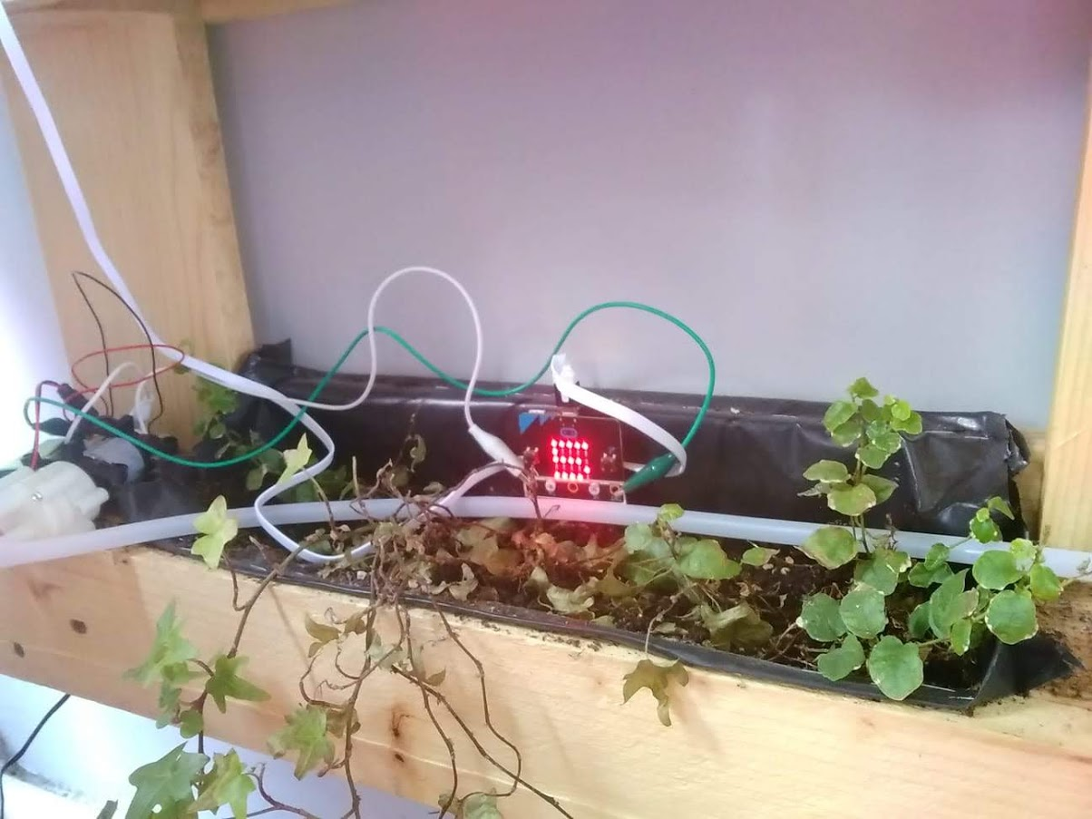
The wall
The wall is watered by microbits

Slide 8
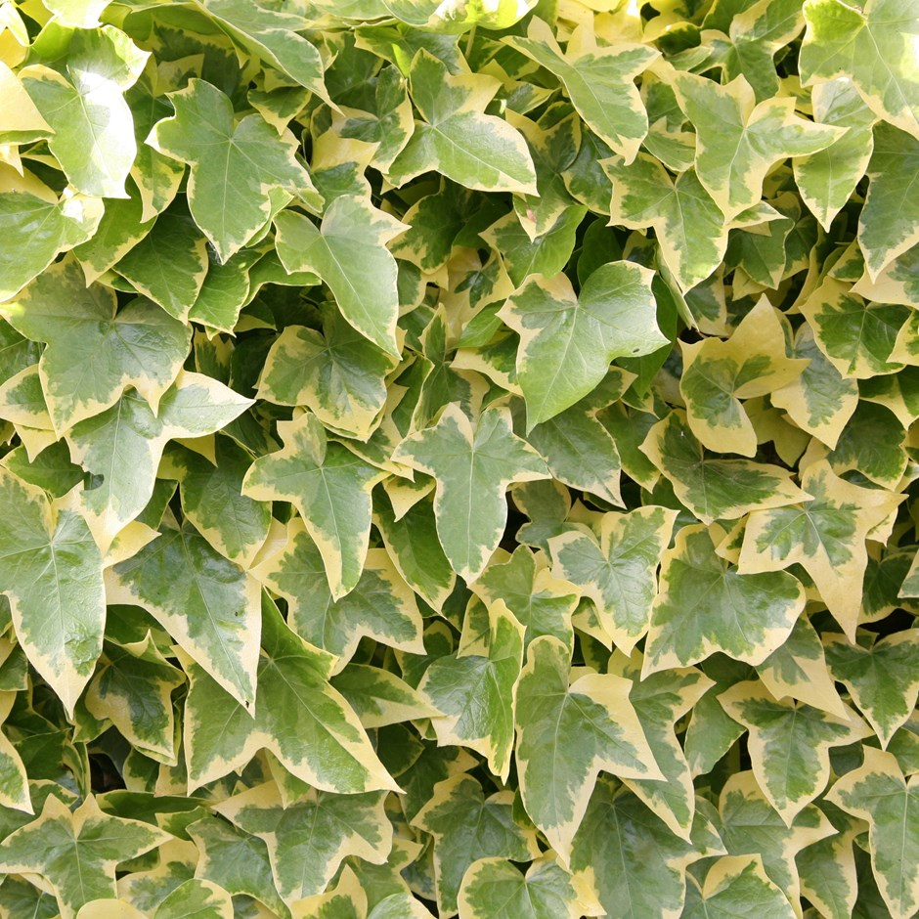
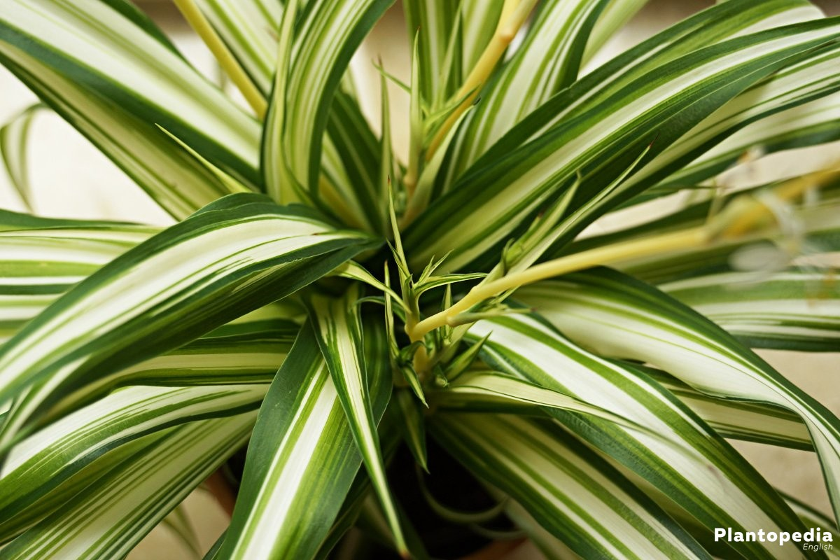
plants
Hedera helix-is a specie of a flowering plant in the family Araliaceae, native to most of Europe and western Asia
Chlorophytum comosum- is a specie of a perennial flowering plant. It is native to tropical and southern Africa

Slide 9
It passed a lot of time since we put up the wall and the plants have growN since then
then
now

Slide 10
THE EDUCATIONAL PATH

Slide 11
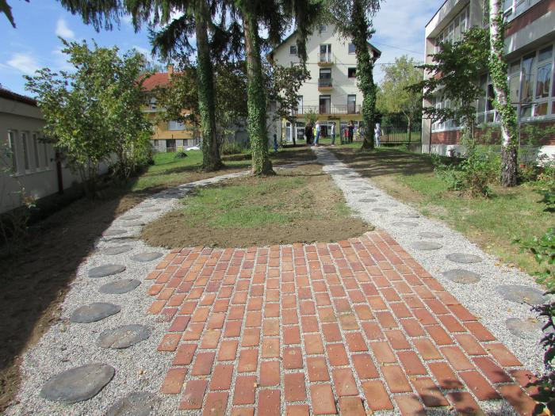

Slide 12
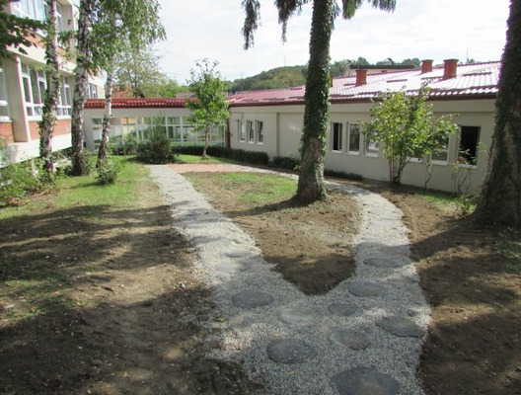
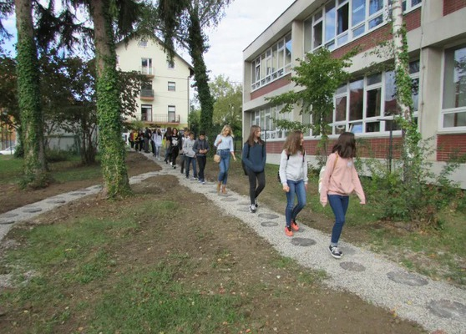
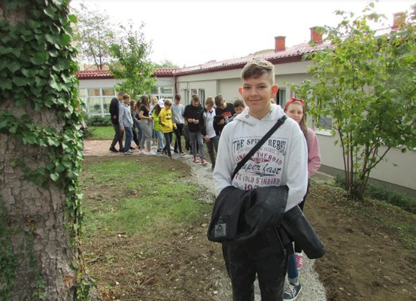
the path is placed in the school yard and it has playful wooden stepping stones
around the path there are different plants and the centerpiece of the path is the windmill
we encourage pupils to have a walk around the path and promote renewable energy sources

Slide 13
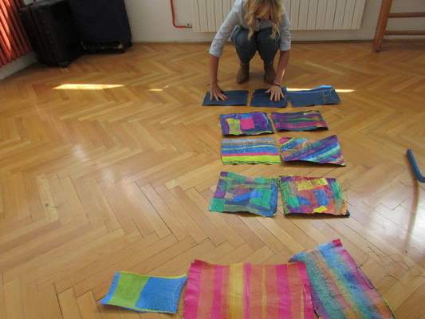
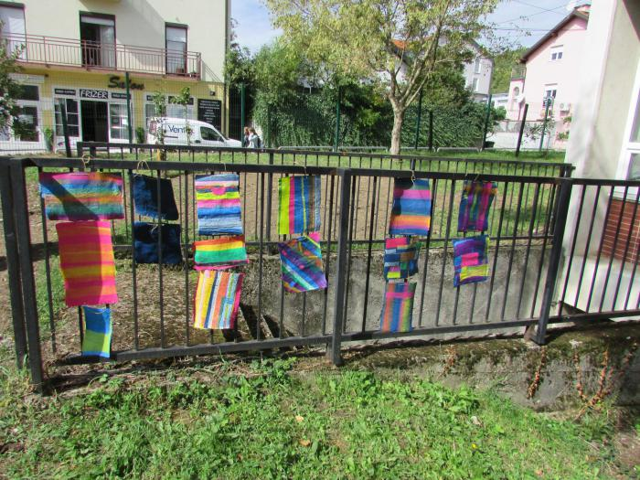
LAND ART DECORATIONS – we recycled plastic bags into abstract mobiles

Slide 14
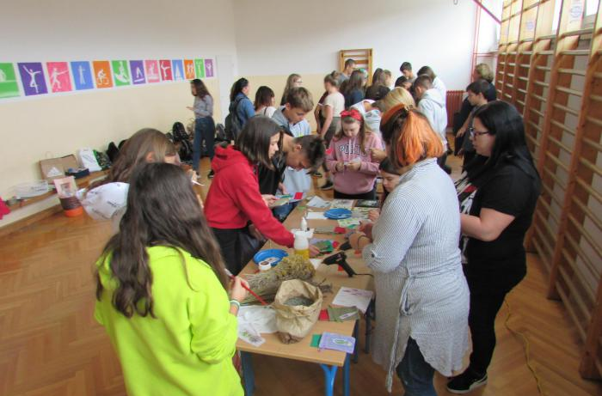
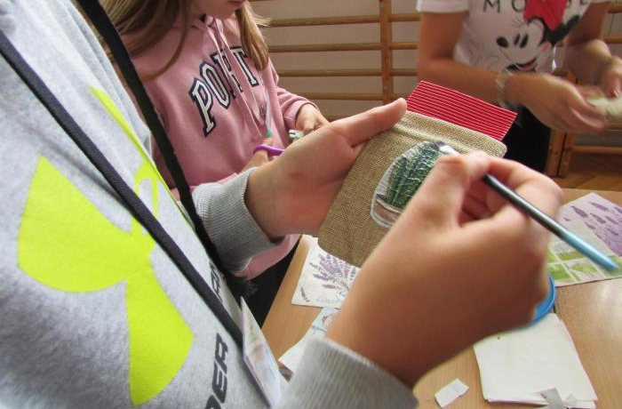
SOUVENIRS

Slide 15
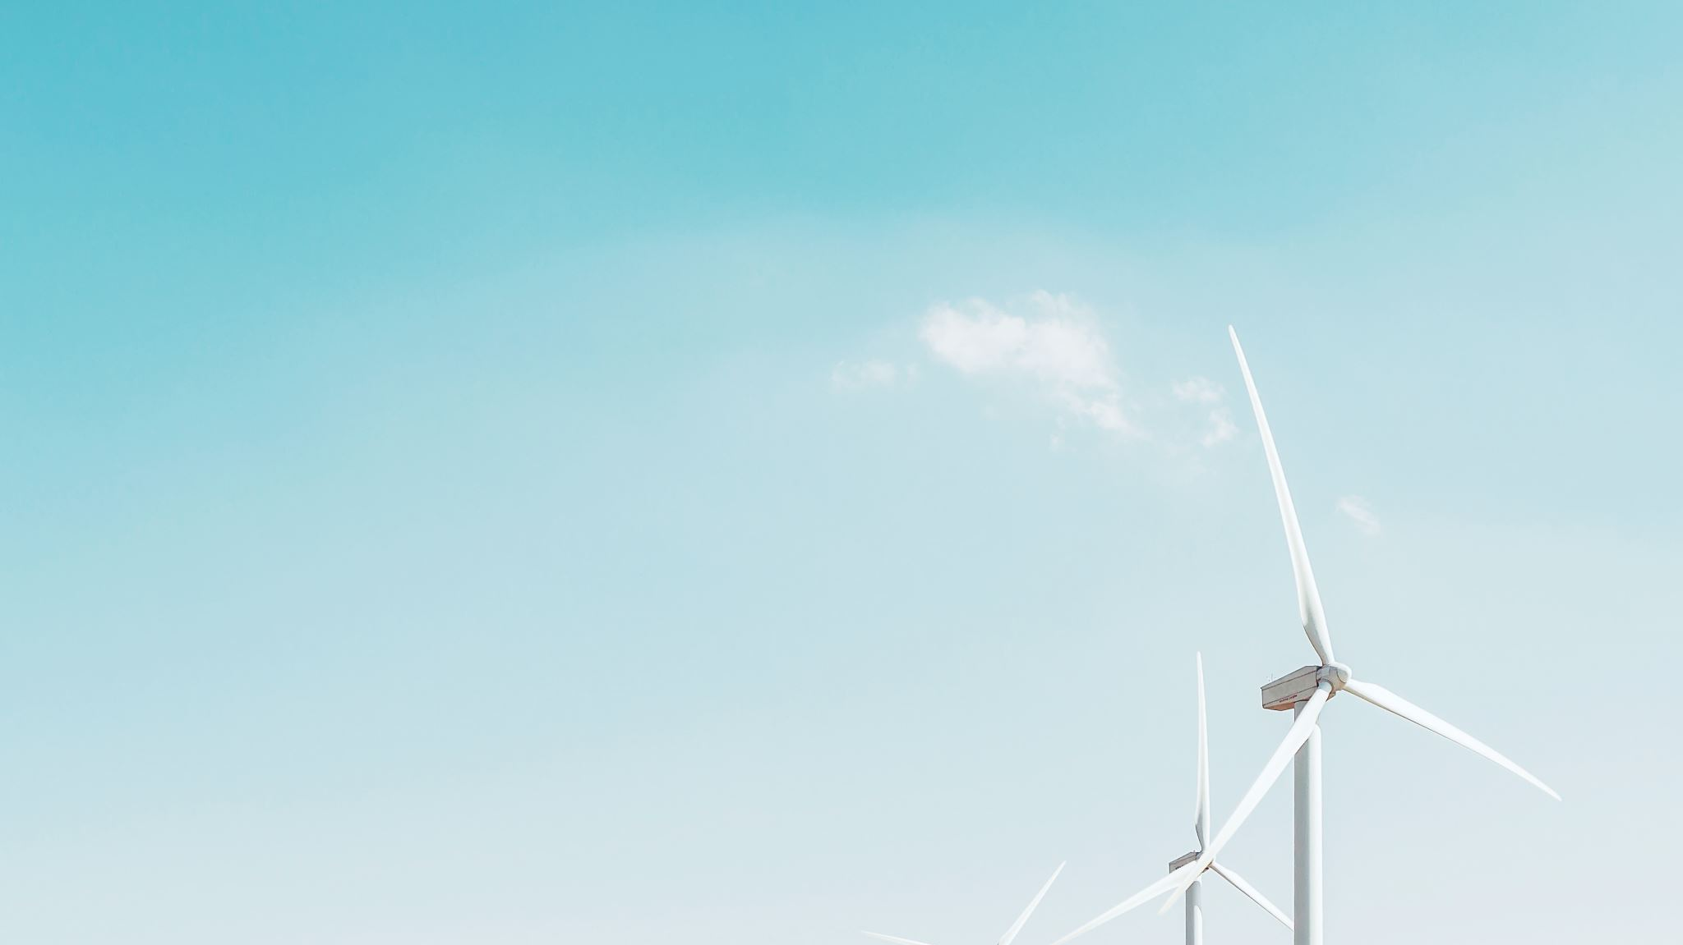
THE WINDMILL

Slide 16
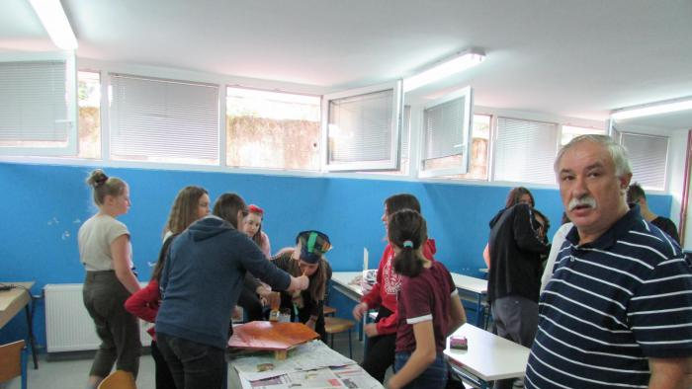

Slide 17
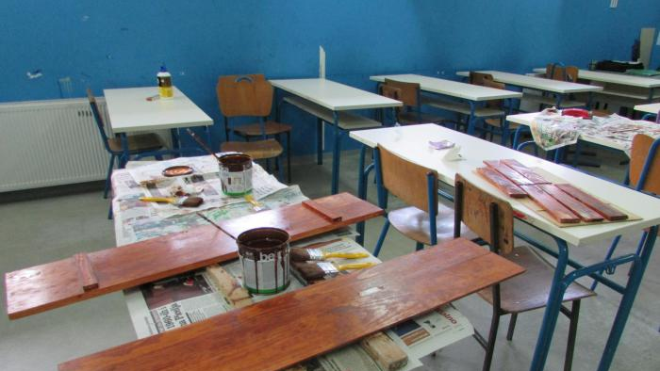

Slide 18
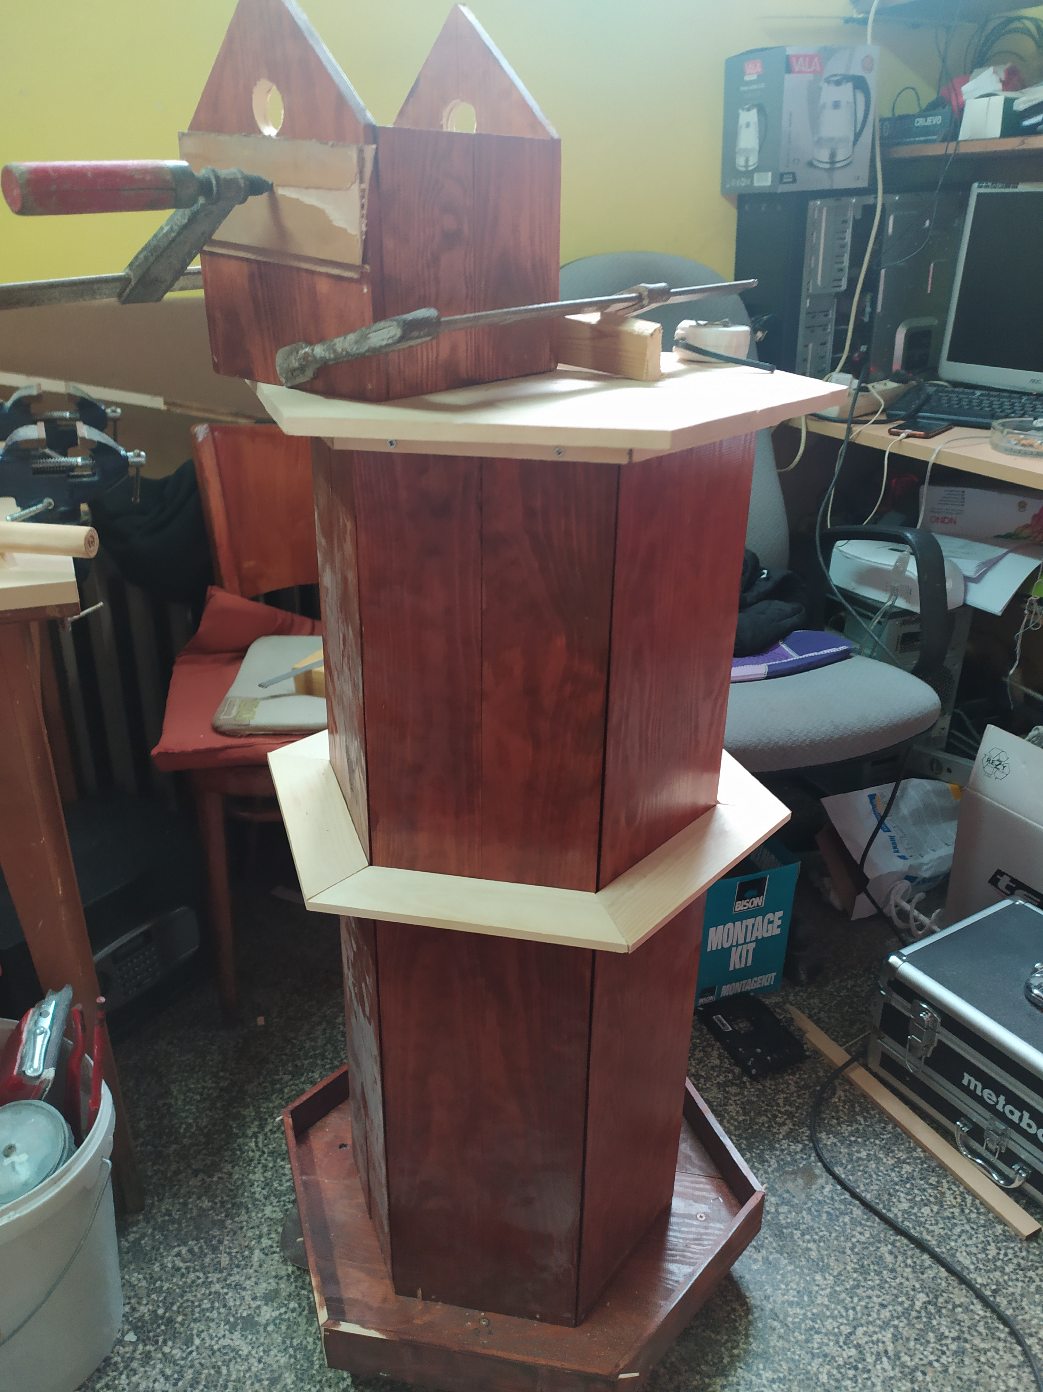
THE WINDMILL
It’s wooden and it is a symbol of renewable energy sources.

Slide 19
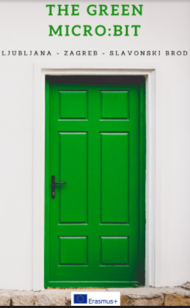
THE E-BOOK
the book describes all project activities

Slide 20
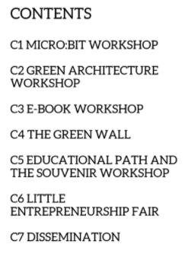


Slide 21
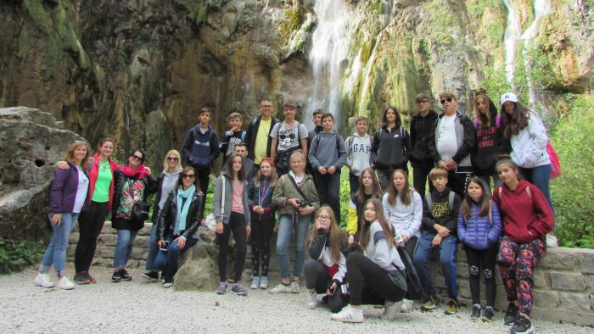
WE HAD LOTS OF FUN AND LEARNED A LOT!

Slide 22
THANK YOU FOR YOUR ATTENTION!

