Slide 1
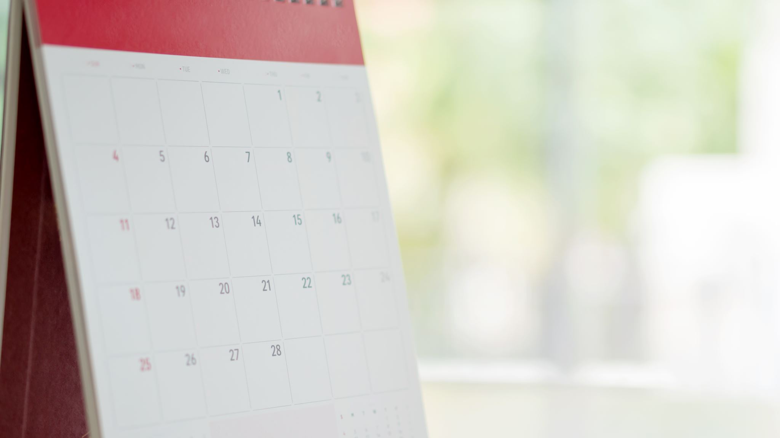
HOW IT ALL STARTED…

Slide 2
Idea to join the Erasmus + programme
Motivation to cooperate with different schools and exchange knowledge and experience
Broadening horizons
A new challenge for the school
Search for project partners
Creating the topic
Writing the project proposal and application

Slide 3
Project aims
Raise awareness about ecological issues
Enhance digital competence
Fostering critical thinking

Slide 4
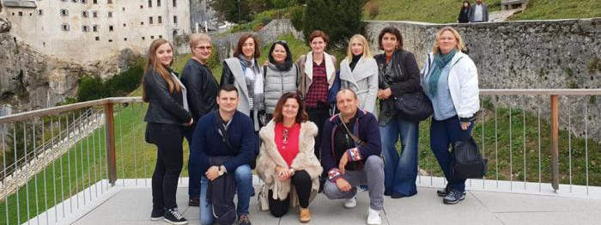
The first training event in Ljubljana

Slide 5
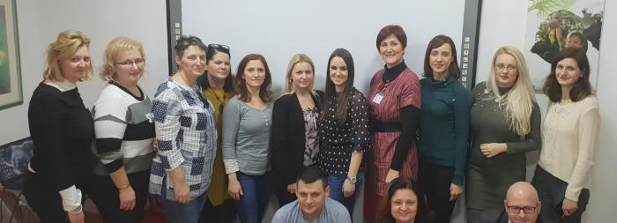
The second training event in Zagreb

Slide 6
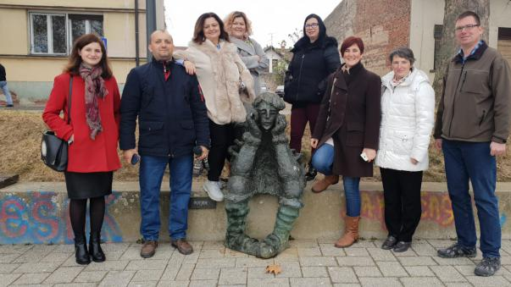
The third training event in Slavonski Brod

Slide 7
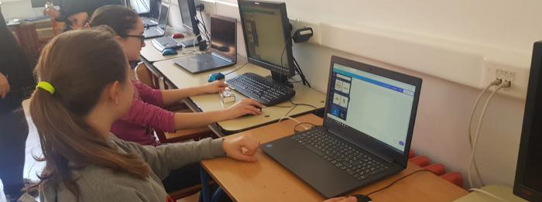
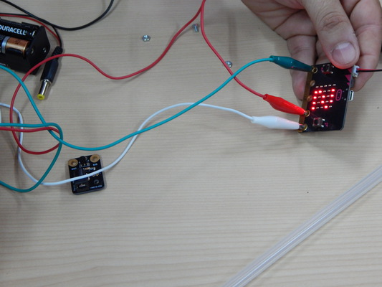
Dissemination
Green wall creation
Micro:bit watering workshop
E-book workshop
Educational path workshop

Slide 8
Pupils’ exchanges

Slide 9
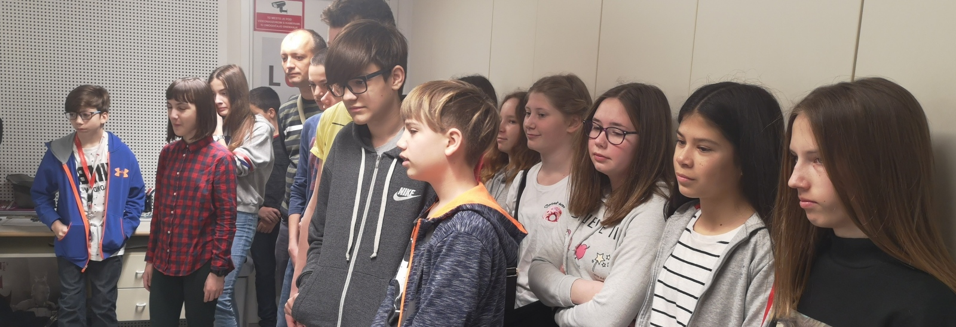
The first exchange in Ljubljana

Slide 10
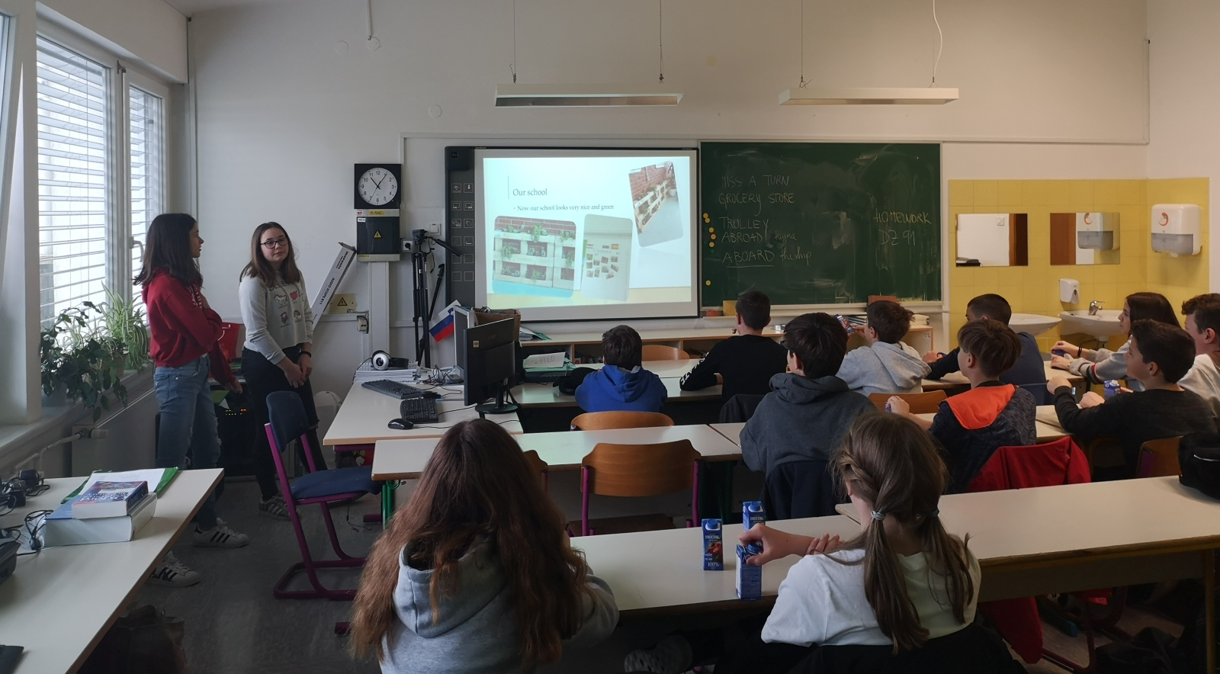

Slide 11
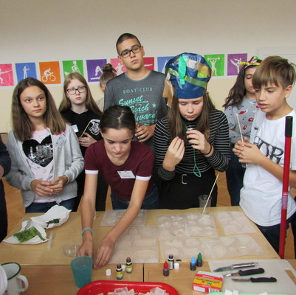
The second exchange in Zagreb

Slide 12
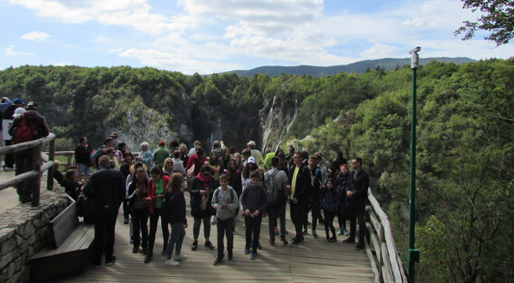

Slide 13
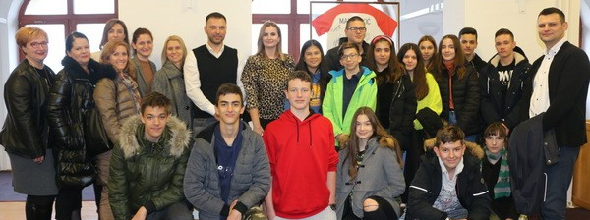
The third exchange in Slavonski Brod

Slide 14
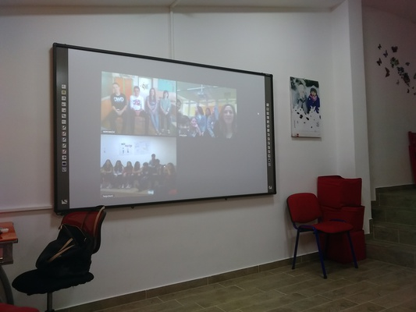
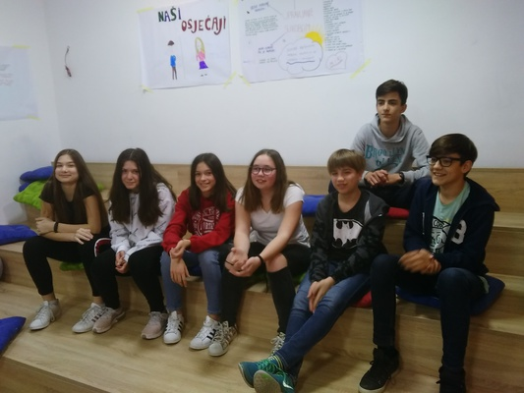
Meetings, meetings, meetings… in between

Slide 15
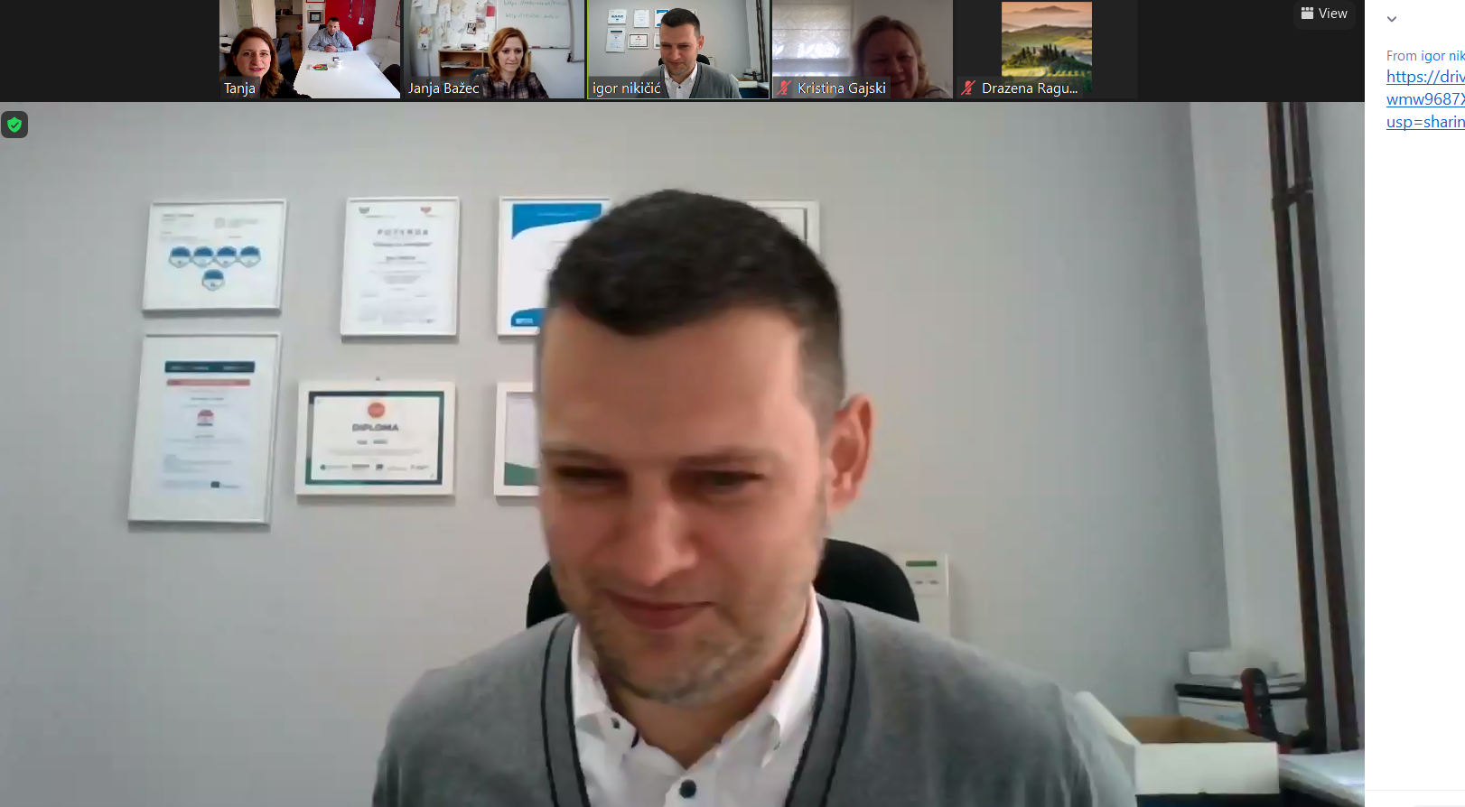

Slide 16

Pupils’ experience and the results

